Slide 1


Link Layer

Slide 2
Link layer
our goals:
understand principles behind link layer services:
  error detection, correction
  sharing a broadcast channel: multiple access
  link layer addressing
  local area networks: Ethernet, VLANs

Slide 3













Link layer: introduction
terminology:
hosts and routers: nodes
communication channels that connect adjacent nodes along communication path: links
  wired links
  wireless links
  LANs
layer-2 packet: frame, encapsulates datagram
global ISP
data-link layer has responsibility of
transferring datagram from one node
to physically adjacent node over a link

Slide 4
Error Control
Network errors
  Types
    Corrupted data
    Lost data
  Caused by problems in transmission (not humans)
Networks should be designed with:
  Error prevention
  Error detection
  Error correction

Slide 5
Error Prevention
Source of Error | What Causes It | How to Prevent or Fix
White Noise | Movement of electrons | Increase signal strength
Impulse Noise | Sudden increases in electricity (e.g., lightning) | Shield or move the wires
Cross-talk | Multiplexer guardbands too small or wires too close together | Increase the guardbands or move or shield the wires
Echo | Poor (misaligned) connections | Fix the connections or tune equipment
Attenuation | Gradual decrease in signal over distance | Use repeaters
Intermodulation noise | Signals from several circuits combine | Move or shield the wires

Slide 6


Error detection
EDC= Error Detection and Correction bits (redundancy)
D = Data protected by error checking, may include header fields
Error detection not 100% reliable!
Parity checking
Internet checksum
otherwise

Slide 7
Error Correction
Once detected, the error must be corrected
Error correction techniques
  Retransmission (or, backward error correction)
    Simplest, most effective, least expensive, most commonly used
    Corrected by retransmission of the data
      Receiver, when detecting an error, asks the sender to retransmit the message
    Often called Automatic Repeat reQuest (ARQ)
  Forward Error Correction
    Receiving device can correct incoming messages without retransmission

Slide 8
Automatic Repeat reQuest (ARQ)
Process of requesting a data transmission be resent
Main ARQ protocols
  Stop and Wait ARQ (A half duplex technique)
    Sender sends a message and waits for acknowledgment, then sends the next message
    Receiver receives the message and sends an acknowledgement, then waits for the next message
  Continuous ARQ (A full duplex technique)
    Sender continues sending packets without waiting for the receiver to acknowledge
    Receiver continues receiving messages without acknowledging them right away

Slide 9
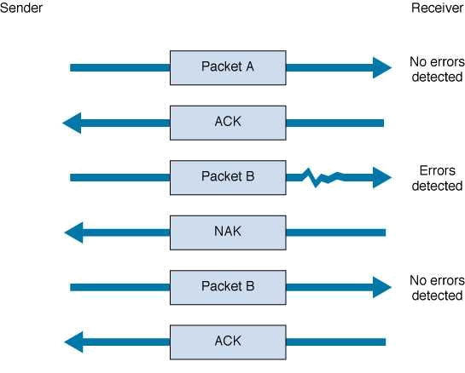
Stop and Wait ARQ
Sender
Receiver
Sends Packet A, then waits to hear from receiver.
Sends
acknowledgement
Sends the next packet (B)
Sends negative acknowledgement
Resends the packet
again
Sends
acknowledgement

Slide 10
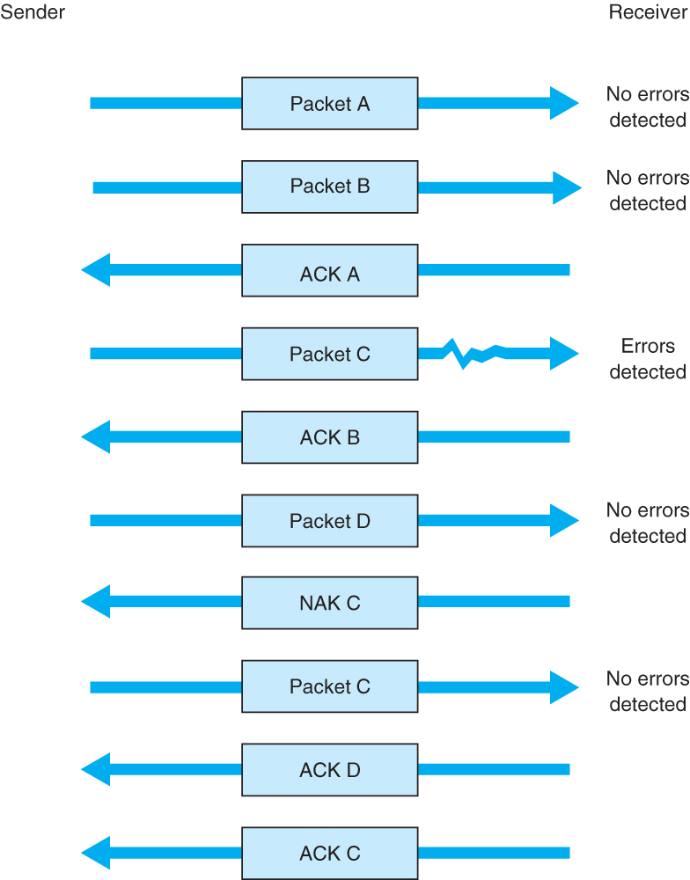
Sender sends packets continuously without waiting for receiver to acknowledge
Notice that acknowledgments now identify the packet being acknowledged.
Receiver sends back a NAK for a specific packet to be resent.

Slide 11
Flow Control with ARQ
Ensuring that sender is not transmitting too quickly for the receiver
  Stop-and-wait ARQ
    Receiver sends an ACK or NAK when it is ready to receive more packets
  Continuous ARQ:
    Both sides agree on the size of the “sliding window”
      Number of messages that can be handled by the receiver without causing significant delays

Slide 12
Flow Control Example
window size = 4
sender
receiver
0 1 2 3 4 5 6 7 8 9
...3 2 1 0
ACK 0...
(slide window)
...4
0 1 2 3 4 5 6 7 8 9
ACK 4...
(slide window)
…8 7 6 5
0 1 2 3 4 5 6 7 8 9
ACK 7..
set window size to 2
(slide window)
..9
0 1 2 3 4 5 6 7 8 9
(timeout)
...9 8
0 1 2 3 4 5 6 7 8 9

Slide 13
Forward Error Correction (FEC)
Receiving device can correct incoming messages itself (without retransmission)
Requires extra corrective information
  Sent along with the data
  Allows data to be checked and corrected by the receiver
  Amount of extra information: usually 50-100% of the data
Used in the following situations:
  One way transmissions (retransmission not possible)
  Transmission times are very long (satellite)
  In this situation, relatively insignificant cost of FEC

Slide 14
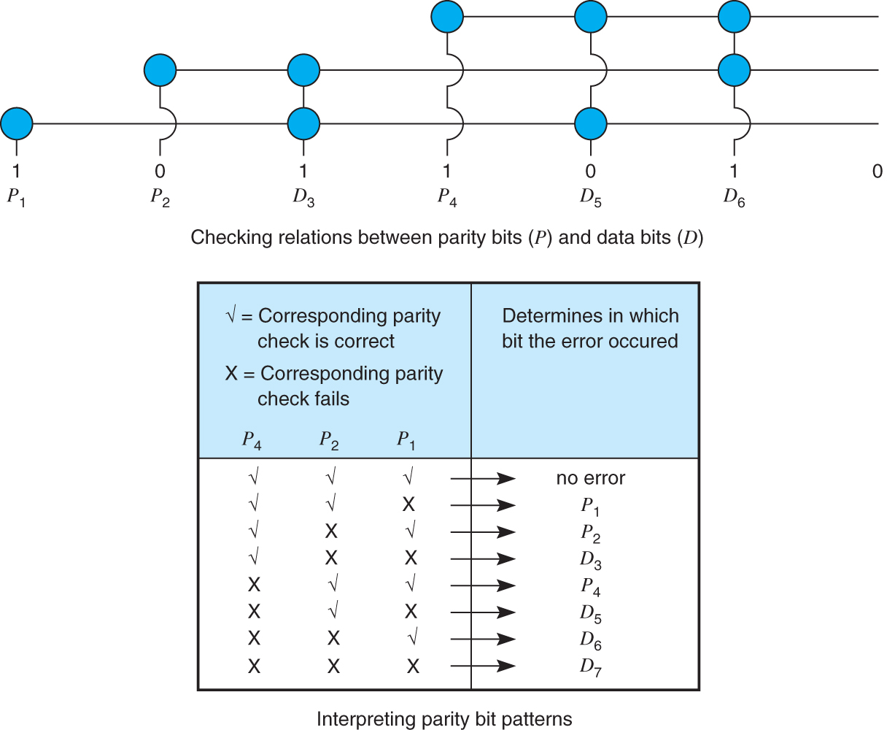
Hamming Code – An FEC Example
D₇
Each data bit figures into three EVEN parity bit calculations
If any one bit (parity or data) changes → change in data bit can be detected and corrected
Only works for one bit errors

Slide 15



Multiple access links, protocols
two types of “links”:
point-to-point
  PPP for dial-up access
  point-to-point link between Ethernet switch, host
broadcast (shared wire or medium)
  old-fashioned Ethernet
  upstream HFC
  802.11 wireless LAN
shared wire (e.g.,
cabled Ethernet)
shared RF
(e.g., 802.11 WiFi)
shared RF
(satellite)
humans at a
cocktail party
(shared air, acoustical)

Slide 16
MAC protocols: taxonomy
three broad classes:
channel partitioning
  divide channel into smaller “pieces” (time slots, frequency, code)
  allocate piece to node for exclusive use
random access
  channel not divided, allow collisions
  “recover” from collisions
“taking turns”
  nodes take turns, but nodes with more to send can take longer turns

Slide 17
Channel partitioning MAC protocols: TDMA
TDMA: time division multiple access
access to channel in "rounds"
each station gets fixed length slot (length = pkt trans time) in each round
unused slots go idle
example: 6-station LAN, 1,3,4 have pkt, slots 2,5,6 idle
6-slot
frame
6-slot
frame
1
3
4
1
3
4

Slide 18
Channel partitioning MAC protocols: FDMA
FDMA: frequency division multiple access
channel spectrum divided into frequency bands
each station assigned fixed frequency band
unused transmission time in frequency bands go idle
example: 6-station LAN, 1,3,4 have pkt, frequency bands 2,5,6 idle
time
frequency bands
FDM cable

Slide 19
Random access protocols
when node has packet to send
  transmit at full channel data rate R.
  no a priori coordination among nodes
two or more transmitting nodes ➜ “collision”,
random access MAC protocol specifies:
  how to detect collisions
  how to recover from collisions (e.g., via delayed retransmissions)
examples of random access MAC protocols:
  slotted ALOHA
  ALOHA
  CSMA, CSMA/CD, CSMA/CA

Slide 20
CSMA (carrier sense multiple access)
CSMA: listen before transmit:
if channel sensed idle: transmit entire frame
if channel sensed busy, defer transmission
human analogy: don’t interrupt others!

Slide 21

CSMA collisions
spatial layout of nodes
collisions can still occur: propagation delay means two nodes may not hear each other’s transmission
collision: entire packet transmission time wasted
  distance & propagation delay play role in in determining collision probability

Slide 22
CSMA/CD (collision detection)
CSMA/CD: carrier sensing, deferral as in CSMA
  collisions detected within short time
  colliding transmissions aborted, reducing channel wastage
collision detection:
  easy in wired LANs: measure signal strengths, compare transmitted, received signals
  difficult in wireless LANs: received signal strength overwhelmed by local transmission strength
human analogy: the polite conversationalist

Slide 23

CSMA/CD (collision detection)
spatial layout of nodes

Slide 24
Ethernet CSMA/CD algorithm
1. NIC receives datagram from network layer, creates frame
2. If NIC senses channel idle, starts frame transmission. If NIC senses channel busy, waits until channel idle, then transmits.
3. If NIC transmits entire frame without detecting another transmission, NIC is done with frame !
4. If NIC detects another transmission while transmitting, aborts and sends jam signal
5. After aborting, NIC enters binary (exponential) backoff:
  after mth collision, NIC chooses K at random from {0,1,2, …, 2^{m}-1}. NIC waits K·512 bit times, returns to Step 2
  longer backoff interval with more collisions

Slide 25
“Taking turns” MAC protocols
channel partitioning MAC protocols:
  share channel efficiently and fairly at high load
  inefficient at low load: delay in channel access, 1/N bandwidth allocated even if only 1 active node!
random access MAC protocols
  efficient at low load: single node can fully utilize channel
  high load: collision overhead
“taking turns” protocols
  look for best of both worlds!

Slide 26

“Taking turns” MAC protocols
polling:
master node “invites” slave nodes to transmit in turn
typically used with “dumb” slave devices
concerns:
  polling overhead
  latency
  single point of failure (master)
data
poll
master
data
slaves

Slide 27
“Taking turns” MAC protocols
token passing:
control token passed from one node to next sequentially.
token message
concerns:
  token overhead
  latency
  single point of failure (token)
T
(nothing
to send)
T
data

Slide 28
MAC addresses and ARP
32-bit IP address:
  network-layer address for interface
  used for layer 3 (network layer) forwarding
MAC (or LAN or physical or Ethernet) address:
  function: used ‘locally” to get frame from one interface to another physically-connected interface (same network, in IP-addressing sense)
  48 bit MAC address (for most LANs) burned in NIC ROM, also sometimes software settable
  e.g.: 1A-2F-BB-76-09-AD
hexadecimal (base 16) notation
(each “number” represents 4 bits)

Slide 29
LAN addresses and ARP
each adapter on LAN has unique LAN address
1A-2F-BB-76-09-AD
LAN
(wired or
wireless)
adapter
71-65-F7-2B-08-53
58-23-D7-FA-20-B0
0C-C4-11-6F-E3-98

Slide 30
LAN addresses (more)
MAC address allocation administered by IEEE
manufacturer buys portion of MAC address space (to assure uniqueness)
analogy:
  MAC address: like Social Security Number
  IP address: like postal address
MAC flat address ➜ portability
  can move LAN card from one LAN to another
IP hierarchical address not portable
  address depends on IP subnet to which node is attached

Slide 31


ARP: address resolution protocol
Question: how to determine
interface’s MAC address, knowing its IP address?
ARP table: each IP node (host, router) on LAN has table
  IP/MAC address mappings for some LAN nodes:
< IP address; MAC address; TTL>
  TTL (Time To Live): time after which address mapping will be forgotten (typically 20 min)
137.196.7.78
1A-2F-BB-76-09-AD
137.196.7.23
137.196.7.14
LAN
71-65-F7-2B-08-53
58-23-D7-FA-20-B0
0C-C4-11-6F-E3-98
137.196.7.88

Slide 32
ARP protocol: same LAN
A wants to send datagram to B
  B’s MAC address not in A’s ARP table.
A broadcasts ARP query packet, containing B's IP address
  dest MAC address = FF-FF-FF-FF-FF-FF
  all nodes on LAN receive ARP query
B receives ARP packet, replies to A with its (B's) MAC address
  frame sent to A’s MAC address (unicast)
A caches (saves) IP-to-MAC address pair in its ARP table until information becomes old (times out)
  soft state: information that times out (goes away) unless refreshed
ARP is “plug-and-play”:
  nodes create their ARP tables without intervention from net administrator

Slide 33
Addressing: routing to another LAN
walkthrough: send datagram from A to B via R
  focus on addressing – at IP (datagram) and MAC layer (frame)
  assume A knows B’s IP address
  assume A knows IP address of first hop router, R (how?)
  assume A knows R’s MAC address (how?)
A
B
R
111.111.111.111
222.222.222.222
74-29-9C-E8-FF-55
49-BD-D2-C7-56-2A
222.222.222.220
1A-23-F9-CD-06-9B
111.111.111.112
111.111.111.110
222.222.222.221
CC-49-DE-D0-AB-7D
E6-E9-00-17-BB-4B
88-B2-2F-54-1A-0F

Slide 34
Addressing: routing to another LAN
A creates IP datagram with IP source A, destination B
A creates link-layer frame with R's MAC address as dest, frame contains A-to-B IP datagram
MAC src: 74-29-9C-E8-FF-55
MAC dest: E6-E9-00-17-BB-4B
IP
Eth
Phy
IP src: 111.111.111.111
IP dest: 222.222.222.222
A
B
R
111.111.111.111
222.222.222.222
74-29-9C-E8-FF-55
49-BD-D2-C7-56-2A
222.222.222.220
1A-23-F9-CD-06-9B
111.111.111.112
111.111.111.110
222.222.222.221
CC-49-DE-D0-AB-7D
E6-E9-00-17-BB-4B
88-B2-2F-54-1A-0F

Slide 35
Addressing: routing to another LAN
frame sent from A to R
frame received at R, datagram removed, passed up to IP
MAC src: 74-29-9C-E8-FF-55
MAC dest: E6-E9-00-17-BB-4B
IP src: 111.111.111.111
IP dest: 222.222.222.222
IP
Eth
Phy
IP src: 111.111.111.111
IP dest: 222.222.222.222
IP
Eth
Phy
A
B
R
111.111.111.111
222.222.222.222
74-29-9C-E8-FF-55
49-BD-D2-C7-56-2A
222.222.222.220
1A-23-F9-CD-06-9B
111.111.111.112
111.111.111.110
222.222.222.221
CC-49-DE-D0-AB-7D
E6-E9-00-17-BB-4B
88-B2-2F-54-1A-0F

Slide 36
Addressing: routing to another LAN
R forwards datagram with IP source A, destination B
R creates link-layer frame with B's MAC address as dest, frame contains A-to-B IP datagram
MAC src: 1A-23-F9-CD-06-9B
MAC dest: 49-BD-D2-C7-56-2A
IP
Eth
Phy
IP
Eth
Phy
IP src: 111.111.111.111
IP dest: 222.222.222.222
A
B
R
111.111.111.111
222.222.222.222
74-29-9C-E8-FF-55
49-BD-D2-C7-56-2A
222.222.222.220
1A-23-F9-CD-06-9B
111.111.111.112
111.111.111.110
222.222.222.221
CC-49-DE-D0-AB-7D
E6-E9-00-17-BB-4B
88-B2-2F-54-1A-0F

Slide 37
Addressing: routing to another LAN
R forwards datagram with IP source A, destination B
R creates link-layer frame with B's MAC address as dest, frame contains A-to-B IP datagram
MAC src: 1A-23-F9-CD-06-9B
MAC dest: 49-BD-D2-C7-56-2A
IP
Eth
Phy
IP
Eth
Phy
IP src: 111.111.111.111
IP dest: 222.222.222.222
A
B
R
111.111.111.111
222.222.222.222
74-29-9C-E8-FF-55
49-BD-D2-C7-56-2A
222.222.222.220
1A-23-F9-CD-06-9B
111.111.111.112
111.111.111.110
222.222.222.221
CC-49-DE-D0-AB-7D
E6-E9-00-17-BB-4B
88-B2-2F-54-1A-0F

Slide 38
Addressing: routing to another LAN
R forwards datagram with IP source A, destination B
R creates link-layer frame with B's MAC address as dest, frame contains A-to-B IP datagram
MAC src: 1A-23-F9-CD-06-9B
MAC dest: 49-BD-D2-C7-56-2A
IP src: 111.111.111.111
IP dest: 222.222.222.222
IP
Eth
Phy
A
B
R
111.111.111.111
222.222.222.222
74-29-9C-E8-FF-55
49-BD-D2-C7-56-2A
222.222.222.220
1A-23-F9-CD-06-9B
111.111.111.112
111.111.111.110
222.222.222.221
CC-49-DE-D0-AB-7D
E6-E9-00-17-BB-4B
88-B2-2F-54-1A-0F

Slide 39


Ethernet
“dominant” wired LAN technology:
cheap $20 for NIC
first widely used LAN technology
simpler, cheaper than token LANs and ATM
kept up with speed race: 10 Mbps – 10 Gbps
Metcalfe’s Ethernet sketch

Slide 40

Ethernet: physical topology
bus: popular through mid 90s
  all nodes in same collision domain (can collide with each other)
star: prevails today
  active switch in center
  each “spoke” runs a (separate) Ethernet protocol (nodes do not collide with each other)
switch
star
bus: coaxial cable

Slide 41
Ethernet frame structure
sending adapter encapsulates IP datagram (or other network layer protocol packet) in Ethernet frame
preamble:
7 bytes with pattern 10101010 followed by one byte with pattern 10101011
used to synchronize receiver, sender clock rates
type
preamble
dest.
address
source
address
data (payload)
CRC

Slide 42
Ethernet frame structure (more)
addresses: 6 byte source, destination MAC addresses
  if adapter receives frame with matching destination address, or with broadcast address (e.g. ARP packet), it passes data in frame to network layer protocol
  otherwise, adapter discards frame
type: indicates higher layer protocol (mostly IP but others possible, e.g., Novell IPX, AppleTalk)
CRC: cyclic redundancy check at receiver
  error detected: frame is dropped
type
preamble
dest.
address
source
address
data (payload)
CRC

Slide 43
Ethernet: unreliable, connectionless
connectionless: no handshaking between sending and receiving NICs
unreliable: receiving NIC doesnt send acks or nacks to sending NIC
  data in dropped frames recovered only if initial sender uses higher layer rdt (e.g., TCP), otherwise dropped data lost
Ethernet’s MAC protocol: unslotted CSMA/CD wth binary backoff

Slide 44
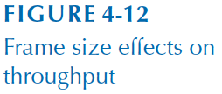
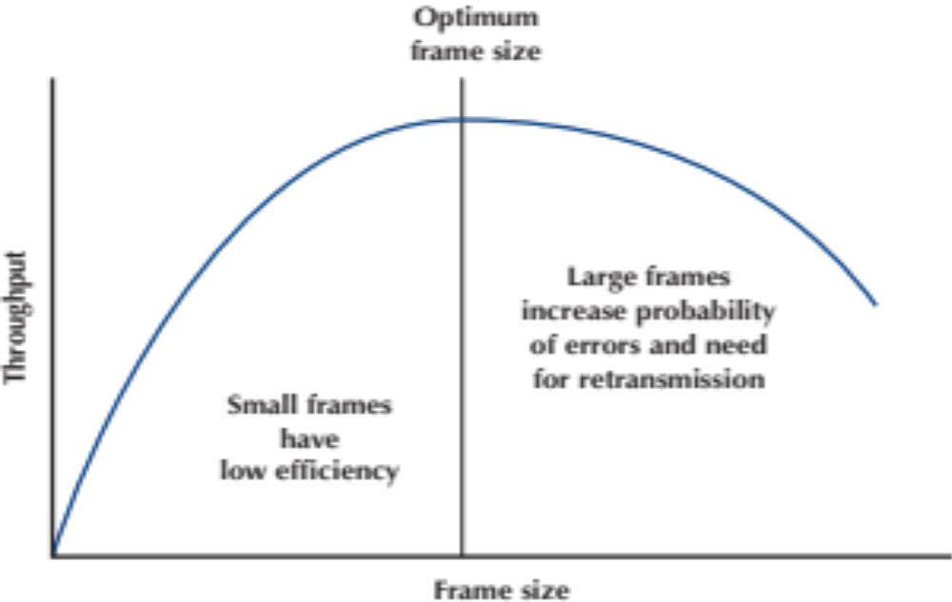
Transmission Efficiency
Transmission efficiency = # of information bits .
# of information + overhead bits

Slide 45
Ethernet switch
link-layer device: takes an active role
  store, forward Ethernet frames
  examine incoming frame’s MAC address, selectively forward frame to one-or-more outgoing links when frame is to be forwarded on segment, uses CSMA/CD to access segment
transparent
  hosts are unaware of presence of switches
plug-and-play, self-learning
  switches do not need to be configured

Slide 46
Switch forwarding table
Q: how does switch know A’ reachable via interface 4, B’ reachable via interface 5?
A
C’
B
A: each switch has a switch table, each entry:
  (MAC address of host, interface to reach host, time stamp)
  looks like a routing table!
6
1
2
5
4
3
B’
C
A’
Q: how are entries created, maintained in switch table?
  something like a routing protocol?
switch with six interfaces
(1,2,3,4,5,6)

Slide 47
Switch: self-learning
Source: A
Dest: A’
switch learns which hosts can be reached through which interfaces
  when frame received, switch “learns” location of sender: incoming LAN segment
  records sender/location pair in switch table
A
A A’
C’
B
6
1
2
5
4
3
B’
C
A’
MAC addr interface TTL
A
1
60
Switch table
(initially empty)

Slide 48
Self-learning, forwarding: example
Source: A
Dest: A’
A
A A’
frame destination, A’, location unknown:
flood
C’
B
destination A location known:
6
1
2
A A’
A A’
A A’
A A’
selectively send
on just one link
A A’
5
4
3
B’
C
A’ A
A’
MAC addr interface TTL
A
1
60
switch table
(initially empty)
A’
4
60

Slide 49
Switches vs. routers
application
transport
network
link
physical
both are store-and-forward:
routers: network-layer devices (examine network-layer headers)
switches: link-layer devices (examine link-layer headers)
both have forwarding tables:
routers: compute tables using routing algorithms, IP addresses
switches: learn forwarding table using flooding, learning, MAC addresses
datagram
frame
link
physical
frame
switch
network
link
physical
datagram
frame
application
transport
network
link
physical

Slide 50


VLANs: motivation
consider:
CS user moves office to EE, but wants connect to CS switch?
single broadcast domain:
  all layer-2 broadcast traffic (ARP, DHCP, unknown location of destination MAC address) must cross entire LAN
  security/privacy, efficiency issues
How?
Computer
Science
Electrical
Engineering
Computer
Engineering

Slide 51
VLANs
port-based VLAN: switch ports grouped (by switch management software) so that single physical switch ……
Virtual Local
Area Network
1
7
9
15
2
8
10
16
switch(es) supporting VLAN capabilities can be configured to define multiple virtual LANS over single physical LAN infrastructure.
…
…
Electrical Engineering
(VLAN ports 1-8)
Computer Science
(VLAN ports 9-15)
… operates as multiple virtual switches
1
7
9
15
2
8
10
16
…
…
Electrical Engineering
(VLAN ports 1-8)
Computer Science
(VLAN ports 9-16)

Slide 52

Port-based VLAN
router
traffic isolation: frames to/from ports 1-8 can only reach ports 1-8
  can also define VLAN based on MAC addresses of endpoints, rather than switch port
1
7
9
15
2
8
10
16
dynamic membership: ports can be dynamically assigned among VLANs
…
…
Electrical Engineering
(VLAN ports 1-8)
Computer Science
(VLAN ports 9-15)
forwarding between VLANS: done via routing (just as with separate switches)
  in practice vendors sell combined switches plus routers

Slide 53
Synthesis: a day in the life of a web request
journey down protocol stack complete!
  application, transport, network, link
putting-it-all-together: synthesis!
  goal: identify, review, understand protocols (at all layers) involved in seemingly simple scenario: requesting www page
  scenario: student attaches laptop to campus network, requests/receives www.google.com

Slide 54



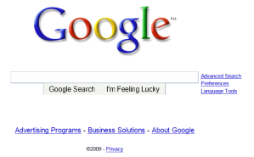
A day in the life: scenario
browser
DNS server
Comcast network
68.80.0.0/13
school network
68.80.2.0/24
web page
web server
Google’s network
64.233.160.0/19
64.233.169.105

Slide 55
A day in the life… connecting to the Internet
DHCP
DHCP
UDP
IP
Eth
Phy
connecting laptop needs to get its own IP address, addr of first-hop router, addr of DNS server: use DHCP
DHCP
DHCP
DHCP
DHCP
DHCP request encapsulated in UDP, encapsulated in IP, encapsulated in 802.3 Ethernet
DHCP
DHCP
UDP
IP
Eth
Phy
DHCP
DHCP
DHCP
DHCP
router
(runs DHCP)
Ethernet frame broadcast (dest: FFFFFFFFFFFF) on LAN, received at router running DHCP server
Ethernet demuxed to IP demuxed, UDP demuxed to DHCP

Slide 56
A day in the life… connecting to the Internet
DHCP
DHCP
UDP
IP
Eth
Phy
DHCP server formulates DHCP ACK containing client’s IP address, IP address of first-hop router for client, name & IP address of DNS server
DHCP
DHCP
DHCP
encapsulation at DHCP server, frame forwarded (switch learning) through LAN, demultiplexing at client
DHCP
DHCP
UDP
IP
Eth
Phy
DHCP
DHCP
DHCP
router
(runs DHCP)
DHCP
DHCP client receives DHCP ACK reply
Client now has IP address, knows name & addr of DNS
server, IP address of its first-hop router

Slide 57
A day in the life… ARP (before DNS, before HTTP)
DNS
UDP
IP
Eth
Phy
before sending HTTP request, need IP address of www.google.com: DNS
DNS
DNS
DNS
ARP
ARP query
DNS query created, encapsulated in UDP, encapsulated in IP, encapsulated in Eth. To send frame to router, need MAC address of router interface: ARP
ARP
ARP reply
Eth
Phy
router
(runs DHCP)
ARP query broadcast, received by router, which replies with ARP reply giving MAC address of router interface
client now knows MAC address of first hop router, so can now send frame containing DNS query

Slide 58
A day in the life… using DNS
DNS
UDP
IP
Eth
Phy
DNS
DNS server
DNS
UDP
IP
Eth
Phy
DNS
DNS
DNS
DNS
DNS
DNS
DNS
DNS
Comcast network
68.80.0.0/13
IP datagram forwarded from campus network into comcast network, routed (tables created by RIP, OSPF, IS-IS and/or BGP routing protocols) to DNS server
router
(runs DHCP)
IP datagram containing DNS query forwarded via LAN switch from client to 1st hop router
demux’ed to DNS server
DNS server replies to client with IP address of www.google.com

Slide 59
A day in the life…TCP connection carrying HTTP
HTTP
HTTP
TCP
IP
Eth
Phy
SYNACK
SYN
SYNACK
SYN
SYNACK
SYN
SYN
to send HTTP request, client first opens TCP socket to web server
router
(runs DHCP)
TCP SYN segment (step 1 in 3-way handshake) inter-domain routed to web server
TCP
IP
Eth
Phy
SYNACK
SYN
SYNACK
SYN
SYNACK
SYN
SYNACK
web server responds with TCP SYNACK (step 2 in 3-way handshake)
web server
64.233.169.105
TCP connection established!

Slide 60
A day in the life… HTTP request/reply
HTTP
HTTP
TCP
IP
Eth
Phy
web page finally (!!!) displayed
HTTP
HTTP
HTTP
HTTP
HTTP
HTTP
HTTP
HTTP
HTTP request sent into TCP socket
router
(runs DHCP)
IP datagram containing HTTP request routed to www.google.com
HTTP
HTTP
TCP
IP
Eth
Phy
HTTP
HTTP
HTTP
web server responds with HTTP reply (containing web page)
HTTP
web server
64.233.169.105
IP datagram containing HTTP reply routed back to client

